Slide 1
RFM ANALYSIS FOR CUSTOMER SEGMENTATION
BASED ON TRANSACTIONS FROM DEC 1, 2010 to DEC 1,2011
Prepared by: Sarumi Abdulkarim

Slide 2

Objective
Goal
To identify customer segments based on transaction behaviours.
Provide actionable insights for marketing campaigns.
Key Outcomes
Understanding who the Best Customers, Loyal Customers, Big Spenders, and Lost Customers are.
Prioritizing customer groups for targeted marketing efforts.

Slide 3
Customer Segments Overview
Segment | % of Customers | Description
Best Customers |  | Most frequent buyers, highest spenders
Loyal Customers |  | Regular and consistent buyers
Potential Loyalists |  | Newer customers showing strong potential
Customers Needing Attention |  | Average engagement, lower spending
Can’t Lose Them |  | Previously valuable but now inactive
At Risk |  | Declining activity, moderate spenders
Hibernating |  | Long-term inactivity, very low spending
Lost |  | No recent activity, minimal engagement

Slide 4
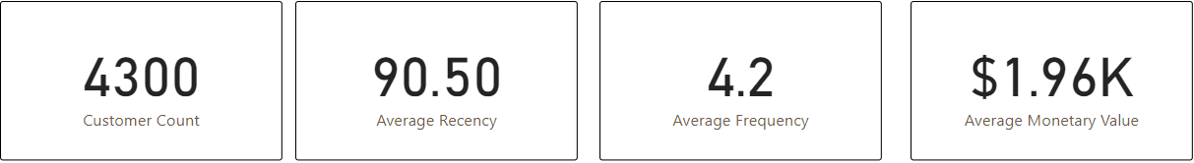
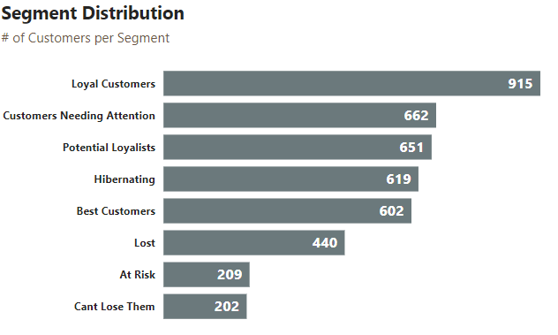
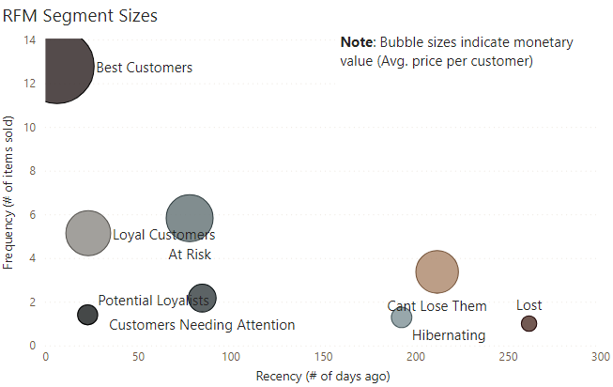
Dashboard Highlights

Slide 5
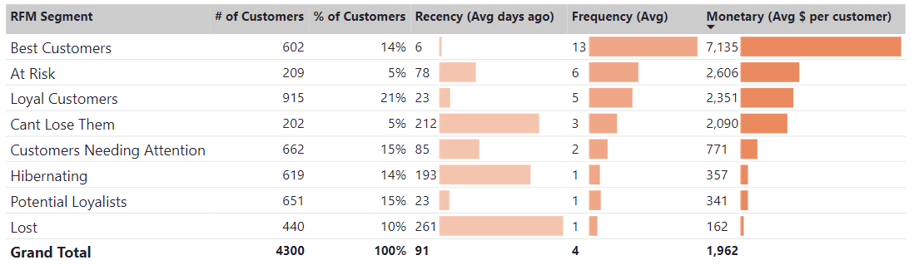
Dashboard Highlights

Slide 6
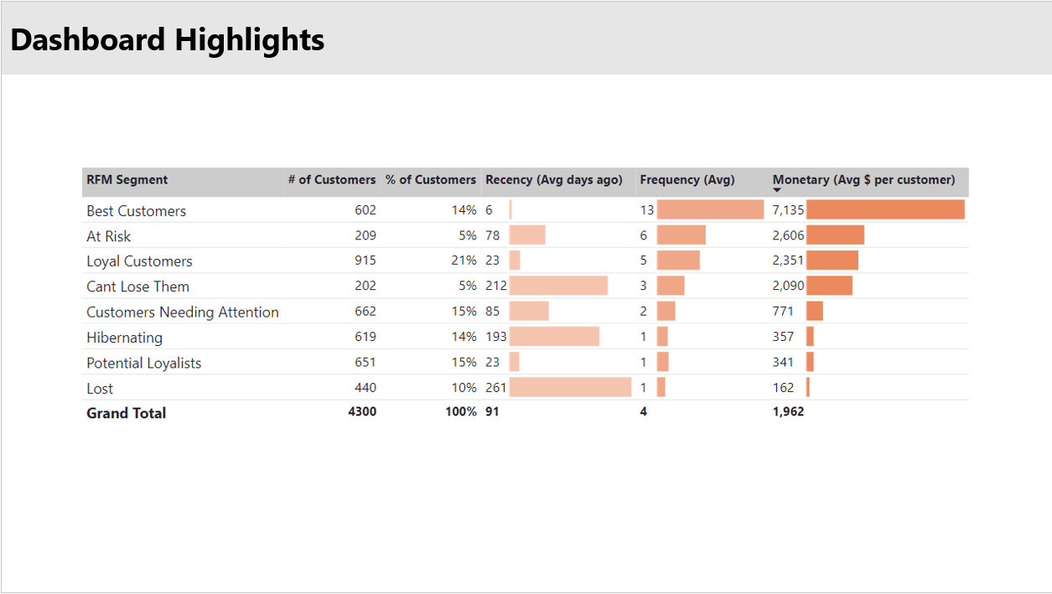
Best Customers
Priority for loyalty and upselling programs.

Slide 7
Loyal Customers
Ideal for retention and cross-selling strategies.

Slide 8
At Risk & Can’t Lose Them
Significant opportunity for reactivation campaigns.

Slide 9
Hibernating & Lost
Requires targeted win-back strategies or gradual disengagement.

Slide 10
Potential Loyalists
Opportunity to nurture into loyal buyers.

Slide 11

Recommendations and Conclusions
Recommendations
Best Customers: Design premium loyalty programs and provide exclusive benefits. Promote upsell opportunities to leverage high spending power.
Loyal Customers: Maintain consistent engagement through personalized offers.
At Risk & Can’t Lose Them: Run targeted reactivation campaigns highlighting their previous value.
Hibernating & Lost Customers: Offer surveys or discounts to re-engage or phase out from campaigns.
Potential Loyalists: Build tailored onboarding programs to solidify loyalty.
Conclusion
RFM analysis highlights the diverse behaviour of customer segments.
Best Customers and Loyal Customers should be prioritized for retention and growth, while At Risk customers need attention to avoid loss.
Next Steps
Deploy segment-specific marketing campaigns.
Monitor customer responses and re-segment quarterly.

Slide 12

Thank you for listening

